Slide 1
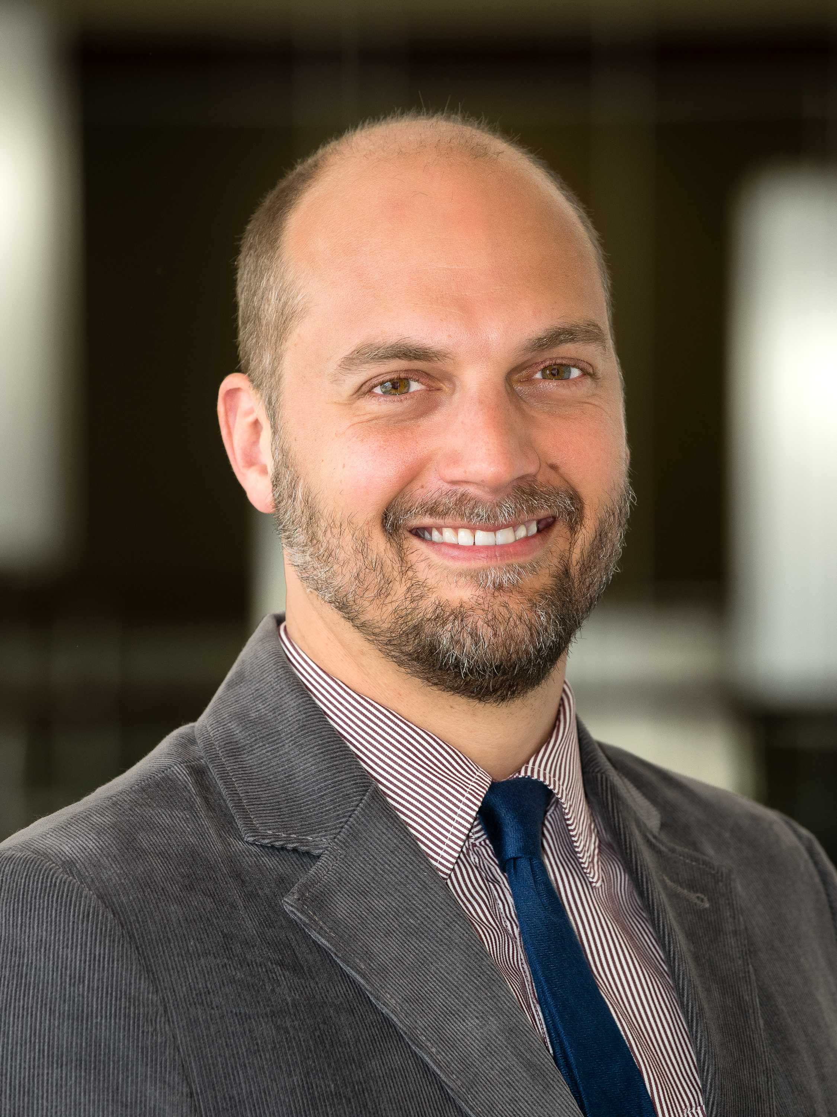
The GROW Project: A Community-Engaged Response to the Opioid Crisis in Northwest Alabama
September 16, 2020
CCN Research Colloquium Series
Joshua C. Eyer, PhD, Capstone College of Nursing
Hee Y. Lee, PhD, School of Social Work
Matthew Hudnall, PhD, Culverhouse College of Business
Megan Sawyer, MSW, School of Social Work

Slide 2
Acknowledgements
Other Investigators
Dr. Jeff Carver (CCIS)
Dr. Rebecca Allen (Psychology)
Dr. Monika Wedgeworth (Nursing)
Dr. Mercy Mumba (Nursing)
Dr. Martha Crowther (CCHS)
Dr. Jason Parton (IBA-CCB)
Community Advisory Board
Dr. Marisa Giggie (CCHS),
Rob Alley (Honors College)
Dr. Billy Kirkpatrick (Five Horizons)
Gwen Thomas-Leblanc (NWAMHC)
Consortium Members
Northwest Alabama Mental Health Center
Lakeland Community Hospital
Departments of Human Resources
PRIDE of Alabama
Five Horizons Health Services
Drs. Sonya Heath and Ricardo Franco at UAB Medicine
Alabama Medicaid
Alabama Department of Public Health
Alabama Department of Mental Health
UA Opioid Workgroup

Slide 3
Outline
US Response to the Opioid Crisis & the RCORP Program
UA-HRSA RCORP Planning Grant
UA-HRSA Implementation Grant

Slide 4
The US Response to the Opioid Crisis

Slide 5
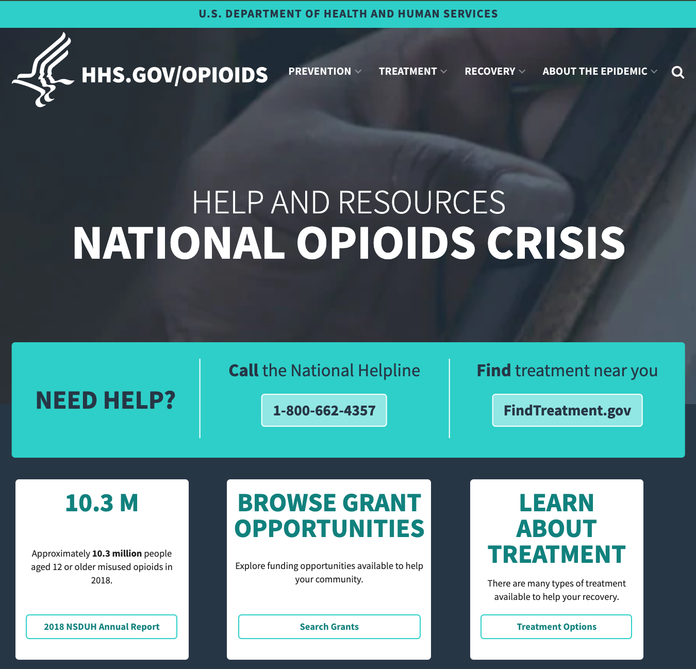
The US is facing an unprecedented drug crisis.

Slide 6
Facts about Opioids
+760,000 deaths since 1999
2 out of 3 deaths due to opioids (2018)
~10.3 million people over 12 misused opioids in 2018.
9.9 million people misused prescription pain relievers
808,000 people used heroin
Common Prescription Opioids:
hydrocodone (Vicodin®), oxycodone (OxyContin®, Percocet®), oxymorphone (Opana®), morphine (Kadian®, Avinza®), codeine, & fentanyl
Opioid Rescue Medications – Naloxone (Narcan)
Notes:
About 1/3 of opioid users say they used heroin first.
https://www.hhs.gov/opioids/about-the-epidemic/opioid-crisis-statistics/index.html
https://www.drugabuse.gov/publications/drugfacts/prescription-opioids

Slide 8
HHS Support
$9 billion in grants (FY2016-2019)
14,000 substance abuse facilities
1.27 million Americans receiving MAT

Slide 9
What It Is: A multi-year initiative supported by HRSA
Purpose: to address barriers to access in rural communities related to substance use disorder (SUD), including opioid use disorder (OUD)
Current Funding: $278 Million (since FY 2018)
Reach: Nationwide (47 states or territories)

Slide 10
RCORP PROGRAMS
RCORP Planning
RCORP Implementation
RCORP MAT Expansion
RCORP Neonatal Abstinence Syndrome (NAS)
RCORP Centers of Excellence
RCORP Technical Assistance
RCORP Evaluation

Slide 11
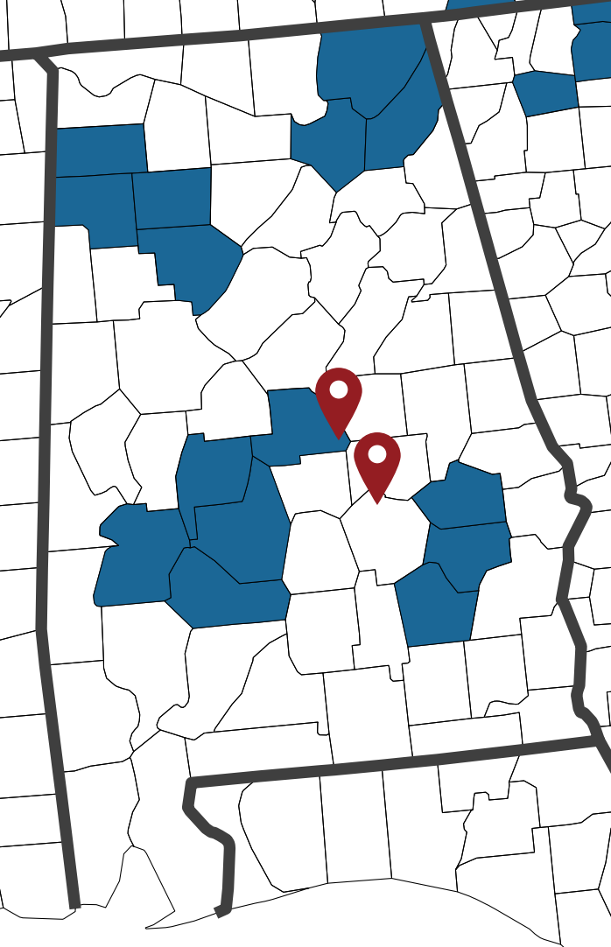
RCORP PLANNING
$200,000 budget
1 year
Purpose: to support treatment for and prevention of substance use disorder, including opioid use disorder (OUD), in rural counties at the highest risk for substance use disorder.
Award recipients are encouraged to cultivate strong county, state, and regional-level partnerships and develop a broad, multi-sectoral consortium
Focus: Enhancing opioid prevention, treatment, and recovery resources and services
Funded: $43 million over 3 years

Slide 12
RCORP IMPLEMENTATION
$1 million budget
3 years
Purpose: to implement a set of evidence-based interventions and promising practices
Focus: Building opioid prevention, treatment, and recovery resources and services
Funded: $170 million over two years

Slide 13
UA HRSA Planning Grant

Slide 14
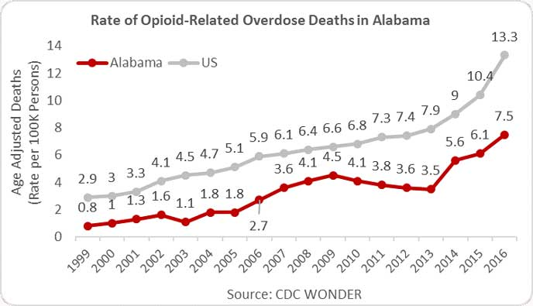
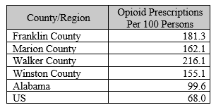
Northwest AL & Opioids
2012: the nation’s highest per capita opioid prescription rate with 143.8 prescriptions per 100 residents

Slide 15
Target Area
Franklin county
Marion county
Winston county
Walker county (rural census tracts)

Slide 16
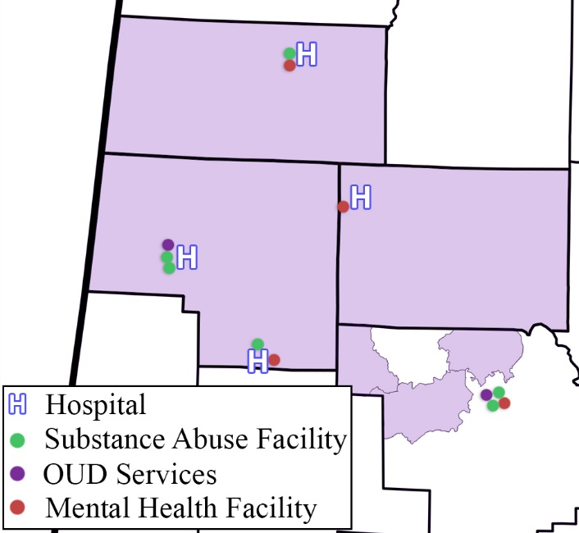
Insufficient Resources
Existing Hospital, Substance Abuse, and Mental Health Facilities for OUD Services
Critical lack of resources, facilities and workforce for opioid prevention, treatment, and recovery

Slide 17
Five Goals of the Project
Goal | Text
#1 | Construct a transdisciplinary community-wide consortium to implement multilevel substance use approach in these rural communities.
#2 | Engage in a comprehensive analysis of the impact and response to OUD/SUD. This action will capitalize on the data collection resources of state and local consortia members and the data analytic resources of University of Alabama members.
#3 | Establish nonjudgmental pathways into care for SUD/OUD that begin with a coherent community emergency response to overdose, particularly opioid toxicity.

Slide 18
Five Goals of the Project
Goal | Text
#4 | Implement sustainable whole-person care by building out available evidence-based services with existing care providers and adding additional behavioral health providers. A key facet of this program is developing a telehealth program utilizing the ECHO model.
#5 | Develop advanced data analytic predictive models of SUD/OUD in Alabama that continuously integrate new data to make updated recommendations about gaps in the response, effectiveness of proposed efforts, and related areas of intervention (e.g., social determinants of health).

Slide 19
Deliverables
Comprehensive Needs Analysis
Strategic Plan
Workforce Plan
Sustainability Plan

Slide 20
Qualitative Method
Research Goal
to better understand individuals’ personal experiences with SUD/OUD, barriers to care, and knowledge of services and needs in the communities
Target Groups
Providers, People who use opioids, & community stakeholders
Recruitment
Individuals were recruited through snowball sampling facilitated by consortium members
Eligibility Criteria
>18 years old, ability to read and write in English, voluntary written informed consent before study entry, and residence in target area.

Slide 21
Qualitative Method
Focus Groups
60-90 minutes
Facilitated by one of three moderators following approved script
Organized by prevention, treatment, and recovery
knowledge, attitudes and perceptions of opioids
opioid overdose, treatment and barriers
community needs/gaps in services and community strengths
education and training

Slide 22
Need Assessment Overview: Prevention
Community
Audience
School
Health Professionals
Education
Opioid Information
Opioid Overdose Response
Topic
Cultural Norms
Easy Access to Opioids
Stigma
Barriers
Prevention Needs & Challenges
Stigma
Guidelines for Staff
Access to Healthcare
Mental Healthcare
Pharmacy
Healthcare Coordination
Monitoring Programs
Figure 1. Prevention-related themes with corresponding codes arising from focus groups conducted with healthcare providers, community members, and people who used/use opioids.
Pain Treatment

Slide 23
Need Assessment Overview: Treatment
Financial
Transportation
Stigma
Barriers
Lack of Motivation
Healthcare Coordination
Lack of Treatment Resources
Treatment Needs & Challenges
Governmental Action
Length of Care
Reimbursement
Family Support
Figure 2. Treatment-related themes with corresponding codes arising from focus groups conducted with healthcare providers, community members, and people who used/use opioids.
Support Group

Slide 24
Need Assessment Overview: Recovery
Unhealthy Network
Barriers
Employment
Recovery Needs &
Challenges
Accessible Recovery Program
Community Resources
Figure 3. Recovery-related themes with corresponding codes arising from focus groups conducted with healthcare providers, community members, and people who used/use opioids.

Slide 25
UA HRSA Implementation Grant

Slide 26
New Implementation Grant
Three Year Period: 09/2020 - 08/2023
Budget: $1,000,000 over the period
The GROW Alabama Project
Greater Rural Opioid Wellness (GROW)
Improving opioid prevention, treatment, and recovery

Slide 27
Drug-Related Data in Project Area

Slide 28
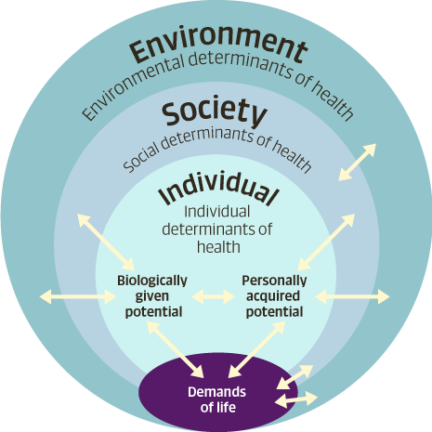
Theoretical Approach
Meikirch Model of Health
proposes health as a complex adaptive system, emerging from the balance between an individual’s Demands of Life and their available potential

Slide 29
Implementation Grant
1. New Interventions: The TeleECHO program, GROW Web App, and GROW List
2. New Networks: Consortium Working Groups, Health Outposts, Recovery Resource Centers, and Peer Recovery Network
3. Data-Driven Activities: The Opioid Centralized Data Repository (OpioidCDR)

Slide 30
GROW Goals - Project
Goal 1. Develop a robust, sustainable project through implementing strong community engagement, a theoretically grounded, whole-person public health approach, and planned data-driven, outcomes-focused quality improvement.
Key Strategies: Consortium & Working Groups and the OpioidCDR

Slide 31
GROW Goals - Prevention
Goal 2. Fulfill Prevention Core Activities by the implementation of a network of Health Outposts and a web-based opioid education application.
Key Strategies: Health Outposts and the GROW web app

Slide 32
GROW Goals - Treatment
Goal 3. Fulfill Treatment Core and Additional Activities by the implementation of a new, easily accessible, provider training intervention and improved access to comprehensive treatment and support resources.
Key Strategies: The Integrated TeleECHO Program and the GROW List

Slide 33
GROW Goals - Recovery
Goal 4. Fulfill Recovery Core Activities by the implementation of new recovery centers in each county and a peer-led recovery initiative
Key Strategies: Recovery Resource Centers and the Peer Recovery Network

Slide 34
GROW ECHO
A Key Strategy: The GROW ECHO Program To Enhance Provider Competence and Comfort

Slide 35
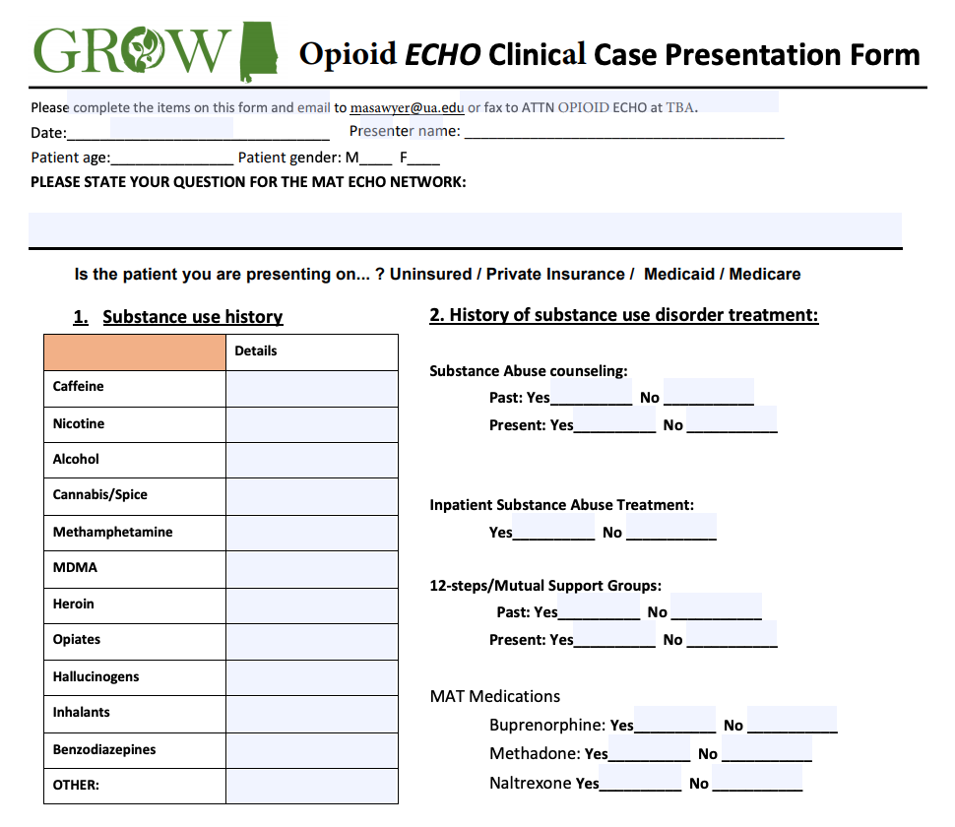
Anatomy of an ECHO
Introductions
Announcements
Brief Didactic (> 30 min)
Patient Case Presentation

Slide 36
Questions and Comments? jceyer@ua.edu

